Slide 1

Comparing Mutual
Information in Finite
Samples
Can MI-specific degrees of freedom improve comparisons between populations?
Daniel Zhao (Master of Computer Science)
Supervisor: Associate Professor Joseph T. Lizier
The University of Sydney
Notes:
Time: 0:25 (finish by 0:25)
SCRIPT
This project asks whether mutual information differs between populations when we have finite samples. I derive MI-specific degrees of freedom for a Welch–Satterthwaite comparison, then examine when its larger rejection cutoff improves false-positive accuracy and what happens to power.
TRANSITION
“The shopping example gives a concrete reason to make this comparison.”
DELIVERY CUE
Face the audience. Use the question rather than reading the affiliation.
SOURCE
Final title, abstract and Chapter 1; preferred-reference page 1.

Slide 2
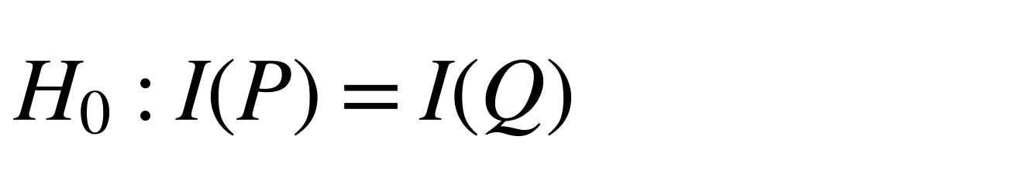
Motivation: comparing MI across populations
Mutual information measures how much observing one variable reduces uncertainty about another. Different sample estimates can arise from sampling noise.
Null hypothesis
$$H_{0}:I\left(P\right)=I\left(Q\right)$$
Online shoppers
Statistical task
P: new visitors
1,694 sessions
corrected MI estimate
0.0043 nats
Draw a count table from each population
Estimate MI from each table
Q: returning visitors
10,551 sessions
corrected MI estimate
0.0179 nats
Assess whether sampling noise can explain the difference
Variables: month of visit and purchase outcome.
Does month–purchase MI differ between the populations?
Month × purchase tables (10×2); corrected MI estimates in nats. Data: Sakar and Kastro (2018). Bossomaier et al. (2016)
2
Notes:
Time: 1:15 (finish by 1:40)
SCRIPT
Mutual information measures the average reduction in uncertainty about one variable when we observe another. Here the variables are the month of a website visit and whether the session ends in a purchase. I compare that association between new and returning visitors, whose population tables I call P and Q.
The corrected sample estimates are about 0.0043 and 0.0179 nats. Their difference motivates the question, but different samples can produce different estimates even when population MI is equal. The null hypothesis therefore equates the two population MI values. It allows different probability tables. We need to account for sampling uncertainty before interpreting the observed difference. I will return to the application after checking the comparison in known populations.
TRANSITION
“The literature supplies several parts of that comparison, with one additional MI-specific calculation needed.”
DELIVERY CUE
Trace groups into estimates, then point to the null. Do not announce the application p-values yet.
SOURCE
Thesis Sections 1.1, 2.1 and 6.4; application row shoppers_month; Bossomaier et al. (2016).

Slide 3
Literature review: foundations and the MI-specific step
Existing results provide MI estimates, a normal-reference comparison and moment matching. This project derives the MI variance sensitivity needed for its degrees of freedom.
 | MI estimation and uncertainty | Normal Wald comparison | Welch–Satterthwaite moment matching
Idea | Estimate MI and first-order sampling variance | Divide the estimated difference by its standard error | Match variance moments to choose degrees of freedom
Key work | Moddemeijer (1989); Paninski (2003) | Mora and Ruiz-Castillo (2009) | Satterthwaite (1946); Welch (1947); Hutcheson (1970); Pan and Wall (2002)
Required step | Track variation in the variance estimate itself | Assess the fixed normal cutoff in finite samples | Calculate the MI-specific variance sensitivity
Contribution: Derive that sensitivity and evaluate the resulting degrees of freedom.
Thesis Sections 2.2–2.5 and 3.2–3.3; full references in B13–B14
3
Notes:
Time: 1:00 (finish by 2:40)
SCRIPT
The project builds on three established strands. Work on MI supplies the estimator, its leading bias correction and its first-order sampling variance. Normal Wald uses those estimates with a standard normal reference. Welch and Satterthwaite instead use variance moments to choose degrees of freedom, with related applications in entropy and other statistical comparisons.
For this MI comparison, the additional calculation is how much the pointwise-MI variance estimate changes when the sampled table changes. Its probability weights, row and column margins, and pointwise-MI values all change together. I derive that sensitivity and evaluate the resulting approximation.
TRANSITION
“The two tests then share a statistic but use different reference distributions.”
DELIVERY CUE
Move across the columns once. Emphasise the required calculation rather than reciting authors.
SOURCE
Thesis Sections 2.2–2.5 and 3.2–3.3; bibliography keys moddemeijer1989, paninski2003, mora2009, satterthwaite1946, welch1947, hutcheson1970 and panwall2002.

Slide 4
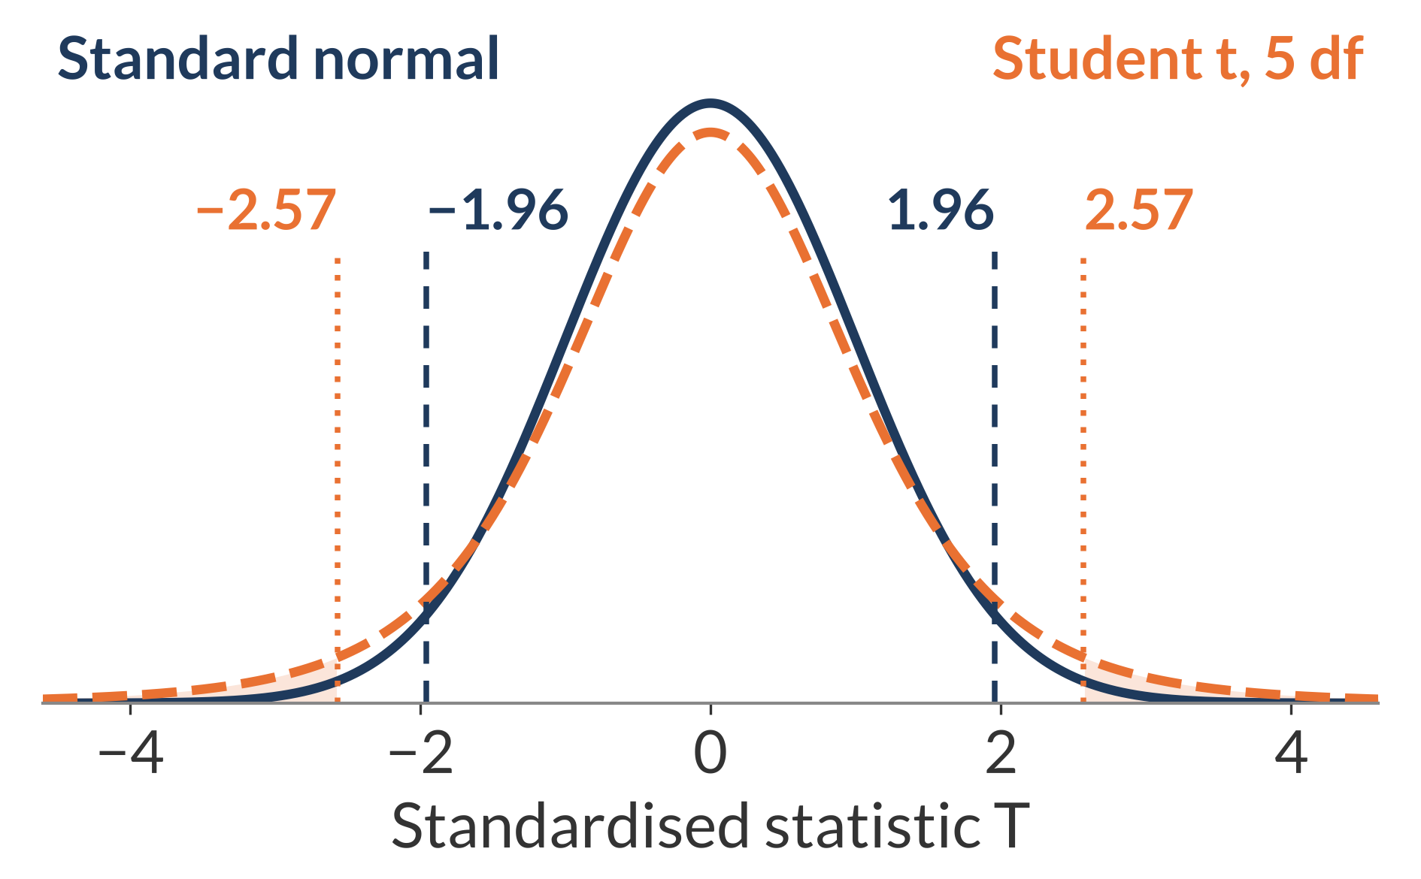
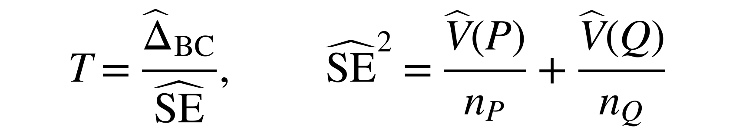
Method: one statistic, two reference distributions
Both methods use the same estimated MI difference and standard error. Expanded Welch uses estimated degrees of freedom for a Student t reference.
Shared statistic
$$T=\frac{{\hat{Δ}}_{BC}}{\hat{SE}}, {\hat{SE}}^{2}=\frac{\hat{V}\left(P\right)}{n_{P}}+\frac{\hat{V}\left(Q\right)}{n_{Q}}$$
Δ̂_{BC}: estimated 𝐼(𝑃) − 𝐼(𝑄), after leading bias correction.
Normal Wald
Expanded Welch
Standard normal distribution; two-sided 5% cutoff about ±1.96.
Student t distribution with estimated degrees of freedom; a larger cutoff.
Student t distribution with 5 degrees of freedom, for illustration; cutoff about ±2.57.
Thesis Chapters 3–4, Figure 2.1. Additional validity rules: Slide 6 and B3
4
Notes:
Time: 1:20 (finish by 4:00)
SCRIPT
Both tests divide the corrected MI difference by the same estimated standard error. Pointwise MI is the information contribution of one category pair. V-hat estimates its variance, and dividing by sample size estimates the sampling variance of an MI estimate. Independence between the samples lets their two variance contributions add.
Wald compares the statistic with the standard normal distribution. Expanded Welch uses a Student t distribution with degrees of freedom estimated from the tables. The illustration uses five degrees of freedom: its heavier tails move the two-sided cutoff from about 1.96 to 2.57. Actual estimated values vary. The larger cutoff means Expanded Welch's rejections are a subset of Wald's under the implemented rules. The experiments assess whether that reduction helps accuracy and how much detection it costs.
TRANSITION
“Choosing the degrees of freedom requires the variability of the variance estimate itself.”
DELIVERY CUE
Point to the common denominator, then cutoffs. Do not imply the illustrated difference is typical of every dataset.
SOURCE
Thesis Chapters 3–4 and Figure 2.1; standard normal and Student t(df=5) quantiles.

Slide 5
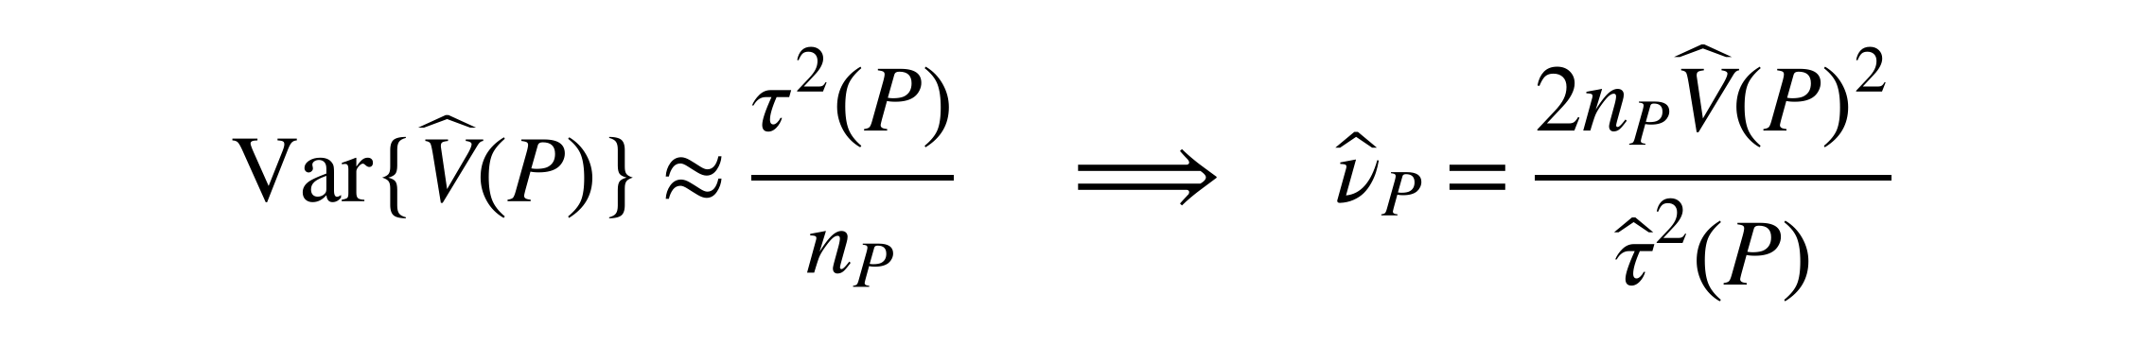
Approach and contribution
Tracking how the pointwise-MI variance changes with the table gives the sampling-variance input for MI-specific degrees of freedom.
Derivation chain
Cell probabilities change
Move a small amount of probability towards one cell.
Margins and pointwise MI change
Track their joint effect.
Variance sensitivity, derived here
𝑔_{𝑃}(𝑥, 𝑦) describes the change in 𝑉(𝑃).
Degrees of freedom
Use the spread of those sensitivities.
Result and approximations
$$Var\{\hat{V}\left(P\right)\}≈\frac{τ^{2}\left(P\right)}{n_{P}} ⇒ {\hat{ν}}_{P}=\frac{2n_{P}\hat{V}{\left(P\right)}^{2}}{{\hat{τ}}^{2}\left(P\right)}$$
Two approximations evaluated
1
First-order sampling expansion
𝜏²(𝑃) is the variance of 𝑔_{𝑃}(𝑋, 𝑌). Repeat for Q and combine using Welch–Satterthwaite.
2
Scaled chi-squared moment matching
Thesis Sections 4.1–4.3; exact derivative in B1, moment matching in B2
5
Notes:
Time: 1:40 (finish by 5:40)
SCRIPT
There are two levels of variation. V-hat describes variation in pointwise MI, but V-hat itself changes when a new sample produces a different table. I calculate how V changes when a small amount of probability moves towards one cell. That perturbation changes the cell weights, margins and log ratios together. The sensitivity g collects those effects.
Averaging observation-level sensitivities gives a first-order approximation to the sampling error of V-hat. Its sampling variance is therefore approximately tau-squared divided by sample size. Satterthwaite moment matching uses twice the squared mean of a variance estimate divided by its sampling variance. Substituting the sample-based inputs gives the component formula shown here. Greater variation relative to the squared mean gives fewer degrees of freedom. I repeat the calculation for Q and combine the components.
The derivative is an exact calculation for positive population tables. Its sampling expansion and the moment-matched Student t reference are approximations, which motivates the first evaluation question.
TRANSITION
“Known population tables let me check those approximations before assessing test decisions.”
DELIVERY CUE
Pause between V-hat and its sampling variance. Explain the chain before the formula. The displayed df are component df, not the combined test df.
SOURCE
Thesis Sections 4.1–4.3; eq:g-final, eq:vhat-sampling-variance, eq:nu-p-hat and eq:expanded-df. B1–B2 retain the full derivative and moment-matching argument.

Slide 6
Evaluation design
Known populations separate approximation accuracy, false positives and power. Both tests receive the same sampled table pairs.
Research questions
Shared simulation grid
RQ1: Approximation accuracy
Sampling moments of 𝑉̂ and component df, including near independence
Four sizes: 2×2, 4×4, 8×8, 16×16
Uniform, same-skew and different-skew margins
Ten sample sizes: 10 to 50,000 observations per population
100,000 independent table pairs per setting
Model: copying construction: choose margins and solve for target MI.
1
2
RQ2: False positives
Equal MI at 0.005, 0.02 and 0.30 nats
3
RQ3: Power
P MI 0.02; MI-gap magnitudes 0.005, 0.01 and 0.02 nats
Reporting: usual 0.05 p-value thresholds. Invalid outputs count as non-rejections; validity is reported separately.
Morris et al. (2019). Thesis Chapter 5, Tables 5.1–5.3; exact vectors, sample sizes and rules in B3
6
Notes:
Time: 1:20 (finish by 7:00)
SCRIPT
I construct population tables with known MI using a copying model that preserves chosen margins. RQ1 checks the variance approximations and the resulting degrees of freedom. The null study uses three common MI values, while power fixes MI in P at 0.02 nats and makes Q larger by three gaps. Nats are MI units based on natural logarithms.
Both test studies cross four table sizes, ten sample sizes and three margin regimes, giving 360 settings each. The uneven margins either agree between populations or differ. Every test sees only its two sampled tables. Repeating the comparison 100,000 times measures performance without increasing the observations available to one test. Both methods use the same pairs and usual p-value thresholds. Invalid calculations count as non-rejections, with validity tracked separately.
TRANSITION
“The first result shows why accurate variance prediction can coexist with an inflated mean.”
DELIVERY CUE
Name what varies and stays fixed. Do not recite ten sample sizes or restore fitted-threshold experiments.
SOURCE
Thesis Chapter 5, Tables 5.1–5.3 and Appendix B; Morris et al. (2019). Current balanced-null and MI-gap grids.

Slide 7
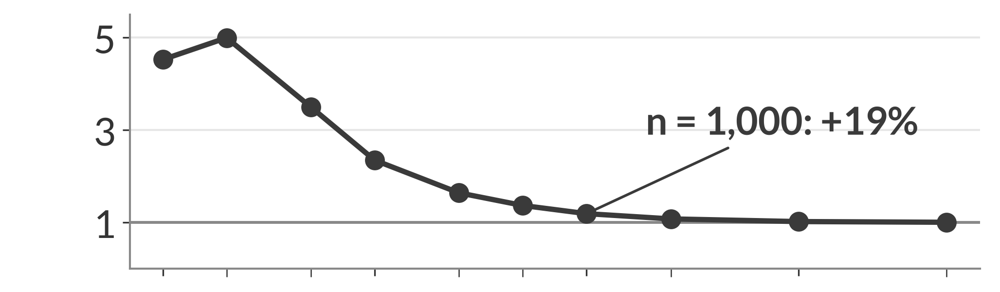
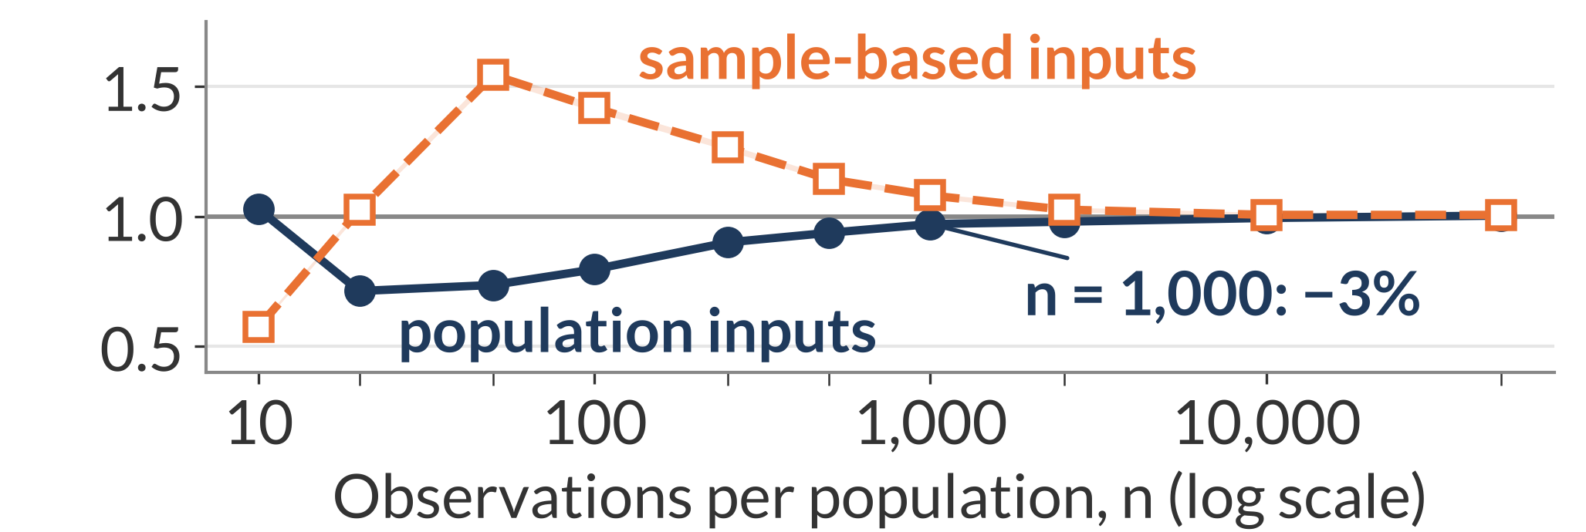
Results: approximation accuracy
The mean of 𝑉̂ can remain inflated even when its population first-order sampling-variance prediction is accurate.
Mean of 𝑉̂ / population 𝑉
Different-skew P · 4×4 · population MI 0.02 nats
Mean: rare cells can inflate it.
Newly observed rare cells can have large pointwise-MI deviations, whose squares raise 𝑉̂.
Sampling variance: linearisation can miss large changes.
Rare cells appear in some samples and not others; sample-based sensitivities can also overpredict the resulting variation.
Predicted / observed sampling variance of 𝑉̂
At n = 1,000: mean 19% high; population variance prediction 3% low. Both moments enter the degrees of freedom.
Thesis Sections 6.1.1–6.1.2, Figures 6.1–6.2. Bands: approximate 95% Monte Carlo intervals. Other sizes and Q: B4
7
Notes:
Time: 1:40 (finish by 8:40)
SCRIPT
This is one population and a four-by-four table, so the two moment errors can be read together. On top, one would mean the average V-hat equals the population variance. The mean rises above that benchmark and then recovers. When rare cells first appear, their estimated pointwise MI can lie far from the table's MI. The squared deviations can inflate V-hat until repeated counts stabilise the estimates.
The lower graph concerns the sampling variance of V-hat itself. Its population first-order prediction misses variation when rare cells appear in some samples and remain absent in others. Estimating the sensitivities from sparse counts can instead overshoot. Larger samples improve both predictions.
At one thousand observations, the population variance prediction is only about three percent low, but the mean is still nineteen percent high. Since the degrees-of-freedom calculation squares the mean input and divides by the variance input, a good variance prediction alone does not make that calculation accurate.
TRANSITION
“Near independence, an additional separation appears because sampling noise creates apparent association.”
DELIVERY CUE
Explain the top graph before the bottom. Say “sampling variance of V-hat”. Tie both annotations to n=1,000.
SOURCE
Thesis Sections 6.1.1–6.1.2, Figures 6.1–6.2; null-display IDs, side=p, k=4, profile=different_skew, MI=.02. B2 retains the numerical df consequence of this same example.

Slide 8
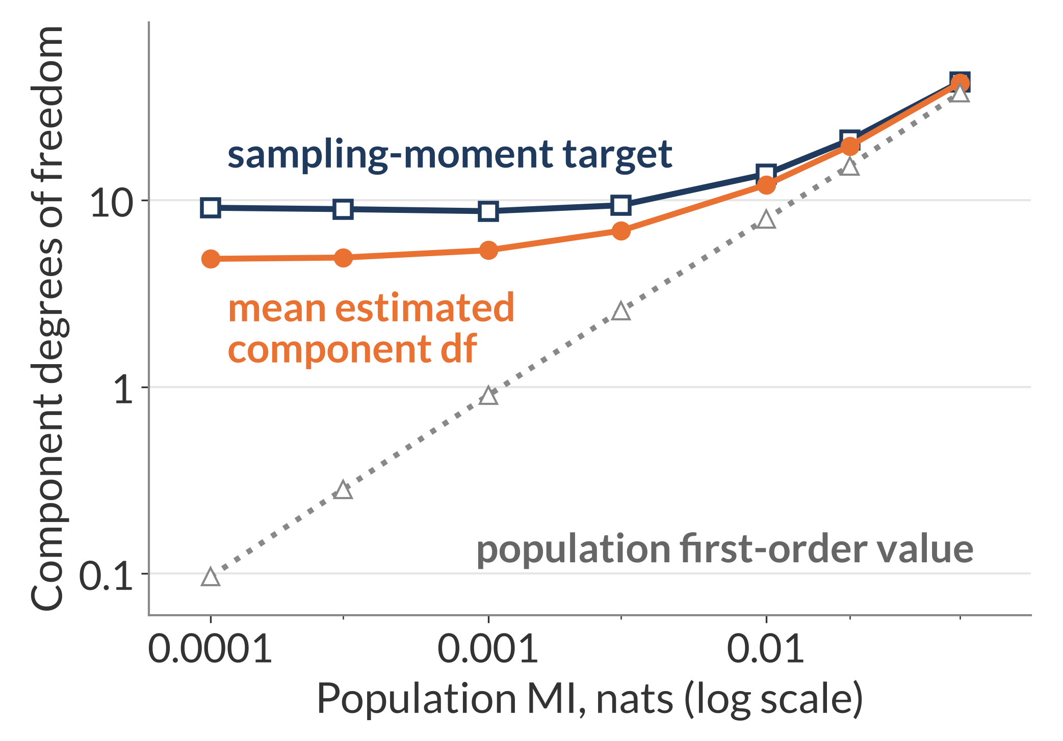
Results: near independence
Near independence, sampling noise keeps the mean estimated component degrees of freedom positive while the population first-order value becomes very small.
Different-skew P · 4×4 · n = 1,000 fixed
Population first-order value
Insert known population inputs into the component formula. Near independence, its local value is approximately n × population MI.
Sample estimate
Quadratic sampling errors create apparent association, which remains in the sample-based calculation.
At MI 0.0001: mean estimated component df ≈4.9; sampling-moment target ≈9.1; population first-order value ≈0.1
Thesis Section 6.1.3, Figure 6.3; Appendix A.2. Bands: approximate 95% Monte Carlo intervals. Local calculation: B5
8
Notes:
Time: 1:40 (finish by 10:20)
SCRIPT
Here sample size stays at one thousand while population MI approaches zero. The grey line inserts known population inputs into the first-order component formula and becomes very small. The orange curve, the mean component degrees of freedom estimated from sampled tables, stays near five at the weakest association. The navy moment target uses the actual sampling mean and variance and is near nine, so the mean estimate is still only about half that target.
At independence, population pointwise MI is zero and the linear sampling contribution vanishes. Sampled tables nevertheless contain apparent association from quadratic sampling errors. The sample-based calculation retains that noise, which explains why its mean stays positive instead of following the population value towards zero. The local calculation in the thesis predicts a mean near 4.6 here, against the observed 4.9. This explains the separation while also showing the limits of the first-order approximation.
TRANSITION
“The decision-level question is whether the larger cutoff brings false positives towards five percent.”
DELIVERY CUE
Point to the low-MI end and explain each curve once. Preserve this slide in every shorter route. The calculation does not prove an exact Student t distribution.
SOURCE
Thesis Section 6.1.3, Figure 6.3 and Appendix A.2; observed mean 4.859787, target 9.124808 and first-order value .096400.

Slide 9
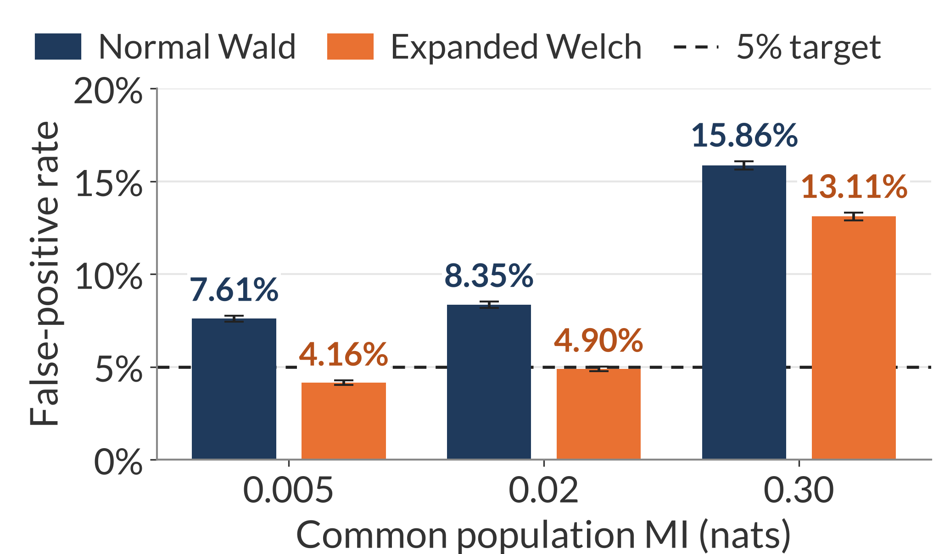
Results: false positives across common MI values
A larger cutoff brings some excessive false-positive rates closer to 5%, but accuracy at one association level does not persist across common MI values.
Uniform 4×4 · n = 20 per population · equal MI in P and Q
Common MI 0.02: closer to 5%
Expanded Welch lowers the rate from 8.35% to 4.90%.
Common MI 0.30: still above 5%
Expanded Welch still rejects in 13.11% of repetitions.
Interpretation: The larger cutoff reduces rejection, while the shared statistic can still have the wrong sampling distribution.
Nominal target: 5%. Both tests are valid in every repetition in these examples.
Slices of the balanced null grid. Whiskers: pointwise 95% Monte Carlo intervals. Thesis Section 6.2.1, Figure 6.4; full grids in B6–B8
9
Notes:
Time: 1:30 (finish by 11:50)
SCRIPT
Each group here uses equal MI in P and Q, so every rejection is a false positive. Table size, margins and sample size stay fixed; only the common MI changes. The dashed line is the five-percent target, navy is Wald and orange is Expanded Welch.
At common MI 0.02, the larger cutoff brings rejection from 8.35 percent to 4.90 percent. At common MI 0.30, rejection still exceeds thirteen percent. Both tests return valid results in every repetition in all three groups, so those departures reflect inference rather than calculation failures.
The cutoff adjustment can offset some errors at a particular population pair, but it does not make the reference accurate across association strengths. Other margin settings also have rates below five percent, where lowering rejection increases conservatism.
TRANSITION
“A matched diagnostic comparison shows why similar uncertainty errors can give opposite rejection behaviour.”
DELIVERY CUE
Common MI changes both populations together; their difference remains zero. Read the highlighted comparisons, not all six labels. No old aggregate counts or A/B/C labels.
SOURCE
Thesis Section 6.2.1, Figure 6.4 and current null rates, k=4, uniform, n_p=n_q=20, denominator=all; six method rows.

Slide 10
Results: why bias changes rejection
Similar errors in estimated uncertainty accompany opposite false-positive behaviour when bias in the MI difference changes.
16×16 · n = 1,000 per population · equal MI 0.02 nats
Margins | Variance ratio | Bias / SD | Normal Wald | Expanded Welch
Same skew | 1.93 | ≈0 | 0.60% | 0.53%
Different skew | 1.94 | 2.06 | 26.01% | 24.84%
Variance ratio: average squared estimated standard error / observed variance of the estimated MI difference.
Same skew
The oversized denominator suppresses the statistic; expected MI biases cancel.
Different skew
The estimated difference is shifted away from zero by unequal residual biases.
Conclusion: Changing the cutoff leaves the biased estimated difference unchanged. Both tests are valid in every repetition here.
Thesis Section 6.2.4, Table 6.1; current null rates and diagnostics. Full different-skew grid: B8
10
Notes:
Time: 1:45 (finish by 13:35)
SCRIPT
These two examples have the same dimensions, sample size and population MI. Their average squared standard errors are almost equally inflated: the variance ratios are about 1.93 and 1.94. Yet their false-positive rates are very different.
With the same margins, the population tables are identical and expected biases cancel in the MI difference. The oversized denominator suppresses the statistic, accompanying rejection below one percent. Expanded Welch lowers that already-conservative rate further.
With different margins, residual biases no longer cancel. The sampling mean of the estimated difference is more than two sampling standard deviations above zero. Both tests then reject around a quarter of repetitions despite the inflated uncertainty estimate. Every calculation is valid in these examples. The larger cutoff changes the decision boundary while leaving the shifted estimate in place, which helps explain why both methods can remain inaccurate.
TRANSITION
“The same larger cutoff also changes the probability of detecting a real MI difference.”
DELIVERY CUE
Compare variance ratios, then bias, then rejection. Name the MI difference as the biased object.
SOURCE
Thesis Section 6.2.4 and Table 6.1; current null rates and diagnostics. Variance ratios 1.928694/1.938104; bias/SD −.002719/2.057921.

Slide 11
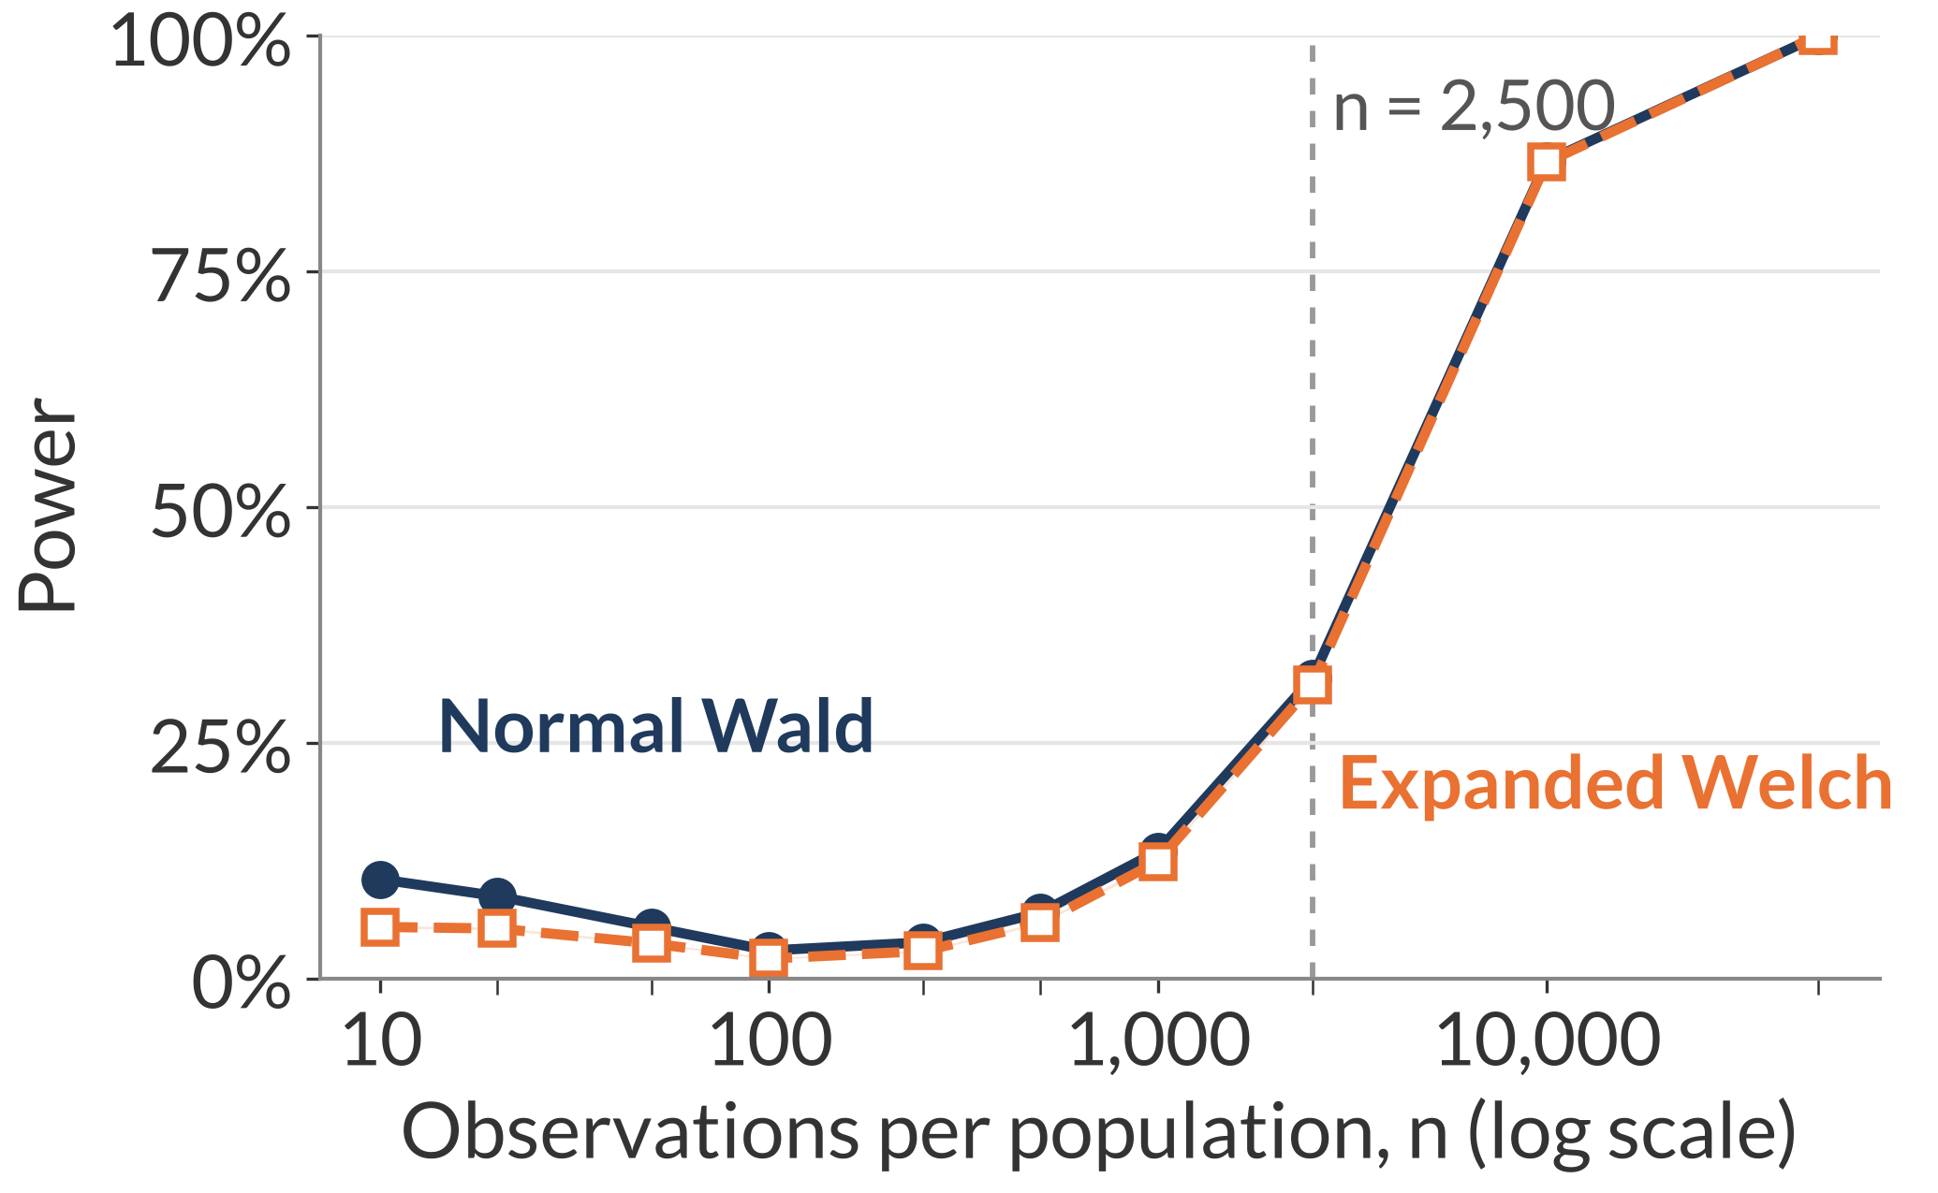
Results: power across MI differences
With sufficient observations, larger MI differences become easier to detect. Expanded Welch's larger cutoff lowers or preserves rejection.
Uniform 4×4 · population MI in P = 0.02 nats
MI-gap magnitude 0.01 nats: power against sample size
Snapshot at n = 2,500
MI-gap magnitude (nats) | Normal Wald | Expanded Welch
0.005 | 11.60% | 11.14%
0.01 | 31.85% | 31.14%
0.02 | 79.24% | 78.74%
Power: probability of rejecting equal MI when population MI differs. Rates use the usual 0.05 p-value threshold.
Rates divide valid rejections by all 100,000 repetitions; invalid outputs count as non-rejections.
Bands: pointwise 95% Monte Carlo intervals. Thesis Section 6.3.1, Figure 6.7; full grids in B9–B11
11
Notes:
Time: 1:30 (finish by 15:05)
SCRIPT
Power is the probability of rejecting equal MI when the population MI values differ. Here P stays at 0.02 nats and Q has greater MI. The graph fixes the gap at 0.01 and increases sample size. As estimates become more accurate and less variable, detection rises. Expanded Welch stays at or below Wald, with the curves becoming close at larger samples.
The table holds sample size at two thousand five hundred and compares all three gaps. Expanded Welch power increases from about eleven percent for the smallest gap to about seventy-nine percent for the largest. That is a local comparison; the full grid also varies dimensions and margins.
These rates use the usual testing thresholds and are interpreted alongside the false-positive results. A two-sided rejection also needs care because it can point towards the wrong population.
TRANSITION
“Different residual biases can make that directional error dominate the apparent detections.”
DELIVERY CUE
Connect the .01 table row to the plotted point. Do not call nominal power matched-size power or restore threshold fitting.
SOURCE
Thesis Section 6.3.1, Figure 6.7; current power rates, all repetitions, k=4, uniform; plot gap=.01 (20 rows), snapshot n_p=2500 (6 rows).

Slide 12
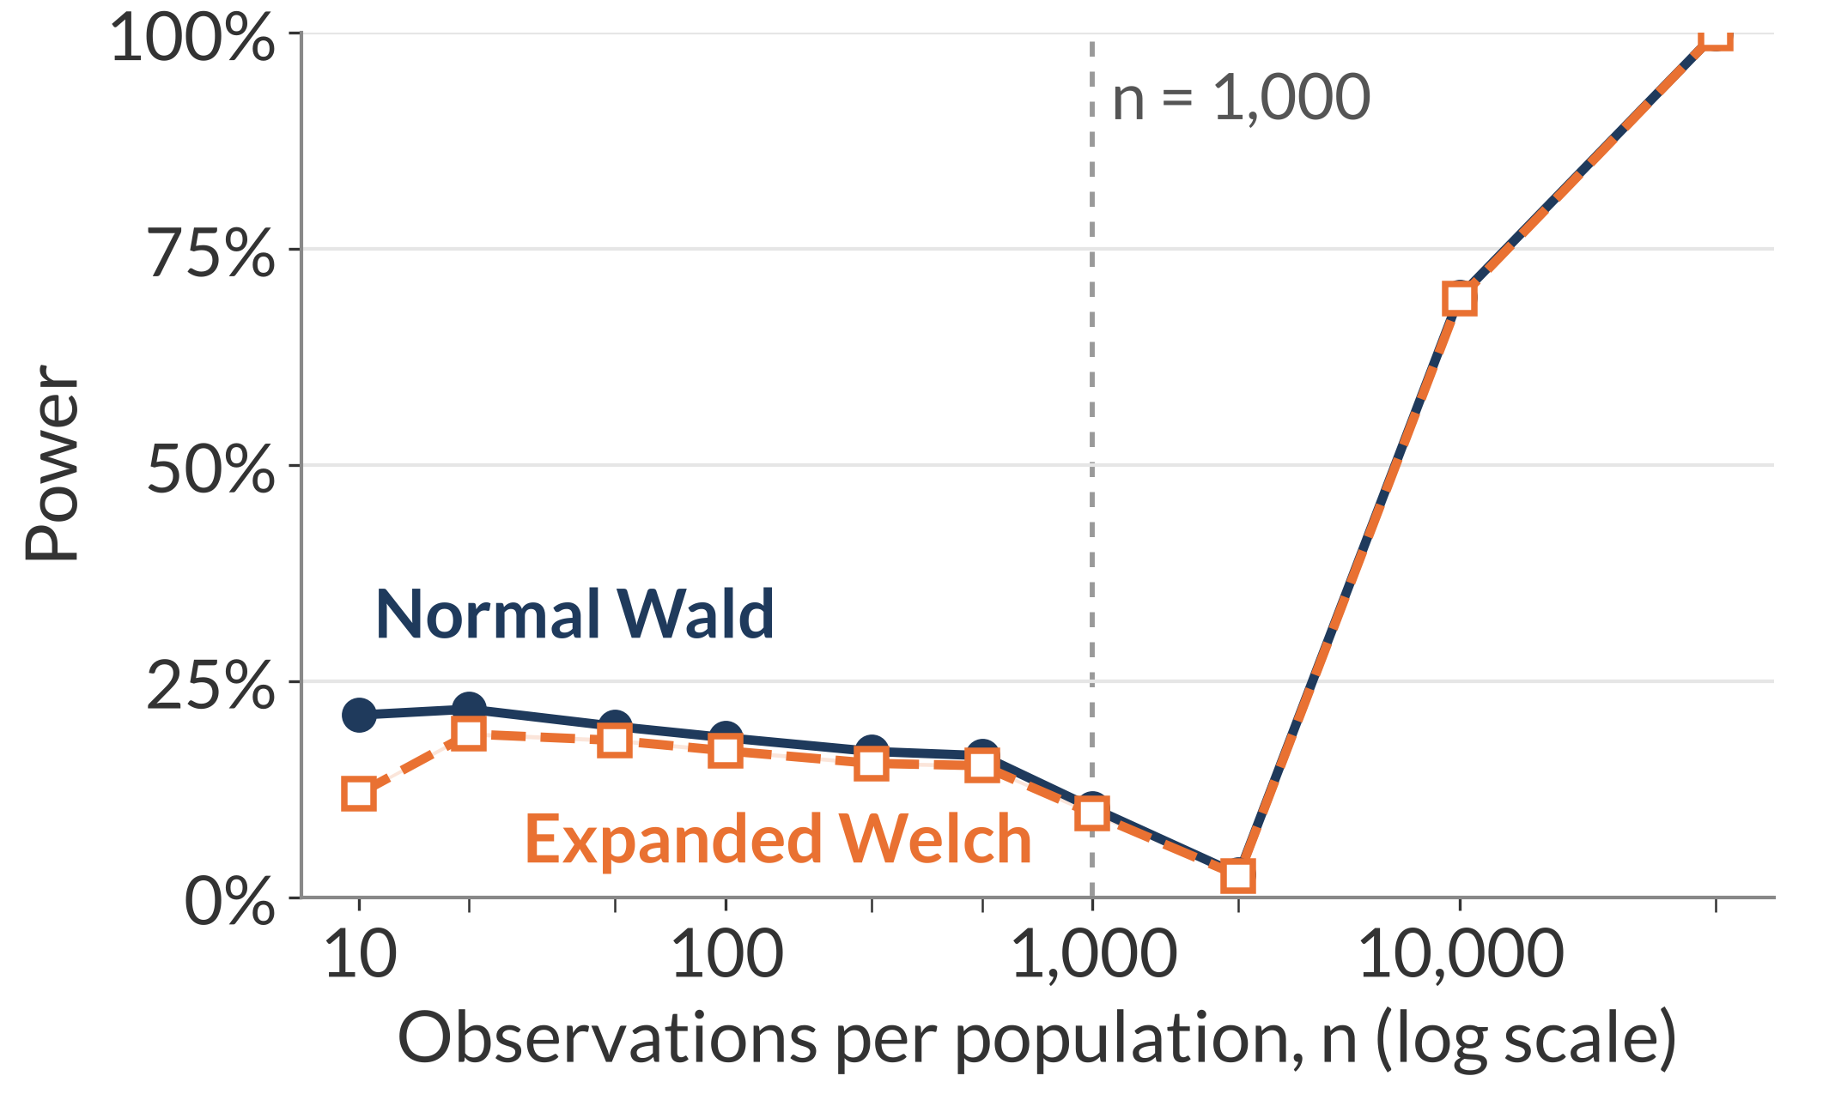
Results: bias can reverse the estimated direction
In sparse tables, unequal residual biases can outweigh the true MI difference and reverse the estimated direction.
Different-skew 16×16 · MI 0.02 versus 0.03 nats
MI-gap magnitude 0.01 nats: power against sample size
At n = 1,000
True difference, P minus Q
−0.0100 nats
Mean estimated difference
+0.0207 nats
Expanded Welch rejects in 9.66% of repetitions.
Among those rejections, over 99.9% have the opposite estimated direction.
Mechanism: As positive bias diminishes, the sampling centre passes near zero, so rejection initially falls before recovering.
At n = 1,000: 9,659 of 9,662 Expanded Welch rejections are positive; both methods 100% valid. Thesis Figure 6.9; full grid in B11
12
Notes:
Time: 1:40 (finish by 16:45)
SCRIPT
The true difference here is minus 0.01 nats, so Q has greater population MI. At one thousand observations per population, however, the mean estimated difference is about plus 0.0207. Unequal residual biases have outweighed the true gap and shifted the sampling centre to the other side of zero.
Expanded Welch rejects in about 9.66 percent of repetitions at that point. Among those rejections, more than 99.9 percent have a positive estimated difference, opposite to the population direction. They count as power under a two-sided definition, but they fail to identify which population has greater MI.
As sample size increases, the positive bias diminishes and the centre moves towards zero. Rejection can initially fall before recovering in the correct direction. Changing the cutoff leaves that biased movement unchanged. The shape therefore requires an explanation of the estimator as well as the rejection threshold.
TRANSITION
“The observed-data application illustrates how to interpret outputs when the population values are unknown.”
DELIVERY CUE
Explain the signed numbers first, then “among the rejections”. Preserve this slide in the shorter route. Both methods are valid in every repetition at the highlighted point.
SOURCE
Thesis Section 6.3.3, Figure 6.9; current power rates/diagnostics, k=16, different_skew, gap=.01. EW positive rejections 9,659, negative 3, total 9,662.

Slide 13
Illustration: online shopping data
Returning visitors have higher estimated month–purchase MI, and both approximate tests reject equal MI after adjustment.
Month × purchase: corrected MI estimates (nats)
Weekend × purchase
New visitors
Returning visitors
Estimates are close; neither test rejects equality.
0.0043
0.0179
Holm-adjusted p-values across six comparisons
Normal Wald 0.000189
Expanded Welch 0.00149
Both tests reject equal MI after Holm adjustment
Interpretation: Population MI is unknown. The simulations provide the evidence about reliability.
Sakar and Kastro (2018): 1,694 new and 10,551 returning sessions. Holm (1979). Thesis Section 6.4; details in B12
13
Notes:
Time: 1:05 (finish by 17:50)
SCRIPT
Returning to the opening question, the corrected month–purchase MI estimate is higher for returning visitors. Both methods reject equal MI, including after Holm adjustment across the six exploratory comparisons. Expanded Welch's adjusted p-value is about 0.00149. The weekend comparison has very close estimates and neither test rejects equality.
These are associations, without a causal interpretation of month. The unknown population tables also mean the application cannot tell us which test has accurate false-positive rates. It illustrates how to read the estimates and test outputs, while the known-population simulations establish the strengths and limitations of the comparison.
TRANSITION
“The contribution and the remaining estimation problems lead to specific next steps.”
DELIVERY CUE
Close the loop with Slide 2. Non-rejection does not establish equality, and Holm adjustment does not repair approximate p-values. Do not read every number.
SOURCE
Thesis Section 6.4, Tables 6.2–6.3, Appendix B.7 and application CSV; Sakar and Kastro (2018), Holm (1979).

Slide 14
Conclusions and next steps
MI-specific degrees of freedom improve some false-positive rates, while remaining failures identify estimation accuracy as a priority.
Contribution and findings
1
2
3
Derived variance sensitivity and MI-specific degrees of freedom.
Brought some excessive false-positive rates closer to 5%; deepened conservatism elsewhere.
Reduced nominal power; residual bias can reverse the estimated direction.
Next steps
Improve bias and uncertainty estimates, including quadratic variation near independence.
Test other association constructions and unequal sample sizes.
1
2
Thank you.
14
Notes:
Time: 1:00 (finish by 18:50)
SCRIPT
I derived the MI-specific variance sensitivity and used it to calculate degrees of freedom for a Welch–Satterthwaite comparison. Its larger cutoff brings some excessive false-positive rates closer to five percent, but also increases conservatism and reduces power under the usual rules.
The sparse-table examples show why the estimates remain central: a cutoff adjustment leaves bias and errors in the standard error unchanged, and bias can reverse the estimated direction. The next steps are to improve those estimates, retain additional sampling variation near independence, and evaluate broader population constructions and unequal sample sizes. The project contributes both the calculation and evidence identifying where it needs further development. Thank you.
DELIVERY CUE
Give contribution and boundary equal emphasis. Face the audience and keep this page visible for questions.
SOURCE
Final abstract; thesis Sections 1.3 and 7.1–7.3. No claim of universal superiority or validated independence-specific replacement test.
BACKUP INDEX (type the slide number, press Enter, then return to 14)
15 Appendix title
16 B1 Variance sensitivity
17 B2 Moment matching and combined degrees of freedom
18 B3 Population construction, grid and validity
19 B4 Approximation ratios across table sizes
20 B5 Near-independence noise calculation
21 B6 Full null results: uniform margins
22 B7 Full null results: same-skew margins
23 B8 Full null results: different-skew margins
24 B9 Full power results: uniform margins
25 B10 Full power results: same-skew margins
26 B11 Full power results: different-skew margins
27 B12 Application details and comparison family
28 B13 References: MI and testing foundations
29 B14 References: related methods and evaluation

Slide 15
Appendix
15
Notes:
Appendix title. Not part of the timed talk.
DELIVERY
No timed speech. Keep the conclusion on Slide 14 visible when questions begin, then open the relevant backup when needed and return to Slide 14 afterwards. The divider adds no time to the 18:50 main talk.

Slide 16
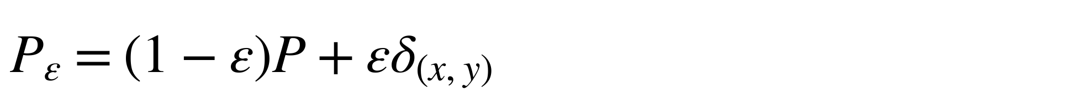
Variance sensitivity
Backup B1
Perturbation towards one cell:
$$P_{ε}=\left(1−ε\right)P+εδ_{\left(x,y\right)}$$
Changing probability weights
$$g_{P}\left(x,y\right)=\{ℓ_{P}\left(x,y\right)−I\left(P\right)\}^{2}−V\left(P\right)$$
Changing pointwise-MI values and margins
$$+2[ℓ_{P}\left(x,y\right)−E_{P}\{ℓ_{P}\left(X,Y\right)∣X=x\}$$
$$−E_{P}\{ℓ_{P}\left(X,Y\right)∣Y=y\}+I\left(P\right)]$$
Pointwise MI:
$$ℓ_{P}\left(i,j\right)=log\{p_{ij}/\left(p_{i+}p_{+j}\right)\}$$
Sensitivity variance:
$$τ^{2}\left(P\right)={Var}_{P}\{g_{P}\left(X,Y\right)\}$$
Exact for positive population tables; its use for sampling errors is first order. Thesis Chapter 4
16
Notes:
Not part of the timed talk. Return to Slide 14 afterwards.
QUESTION ANSWERED
What exactly did you differentiate, and where do the margin terms enter?
ANSWER TO GIVE
“I differentiate the pointwise-MI variance along a one-observation perturbation. The first part changes the probability weights. The bracket also changes the log ratios, including their row and column margins. Both contributions are necessary because the pointwise-MI values themselves depend on the table.”
NOTES
Regularity assumptions: fixed categories, independent observations within each sample, independent samples, positive population cell probabilities, and positive V and tau-squared for the first-order degrees-of-freedom construction. Positive MI alone does not guarantee positive tau-squared. A zero component is not an ordinary finite degrees-of-freedom value.
SOURCE
Thesis Chapter 4: perturbation path (eq:contamination-path), final form of g (eq:g-final) and definition of tau-squared (eq:tau-definition). This derivative is exact for positive population tables. Its use for sampling errors is first order.

Slide 17


Moment matching and combined degrees of freedom
Backup B2
Component degrees of freedom
$$ν_{P,mom}=\frac{2{\left[E\{\hat{V}\left(P\right)\}\right]}^{2}}{Var\{\hat{V}\left(P\right)\}}, {\hat{ν}}_{P}=\frac{2n_{P}\hat{V}{\left(P\right)}^{2}}{{\hat{τ}}^{2}\left(P\right)}$$
Combined degrees of freedom
$$\hat{ν}=\frac{\{\hat{V}\left(P\right)/n_{P}+\hat{V}\left(Q\right)/n_{Q}\}^{2}}{\{\hat{V}\left(P\right)/n_{P}\}^{2}/{\hat{ν}}_{P}+\{\hat{V}\left(Q\right)/n_{Q}\}^{2}/{\hat{ν}}_{Q}}$$
Moment matching does not establish the normality or independence needed for an exact Student t distribution.
Satterthwaite (1946). Thesis Sections 4.1 and 4.3
17
Notes:
Not part of the timed talk. Return to Slide 14 afterwards.
QUESTION ANSWERED
Where do the component and combined df formulas come from, and why is the Student t reference approximate?
ANSWER TO GIVE
“A scaled chi-squared variable has variance twice its squared mean divided by its degrees of freedom. Matching those two moments gives the target. Dividing V-hat by fixed sample size rescales the squared mean and variance equally, so it leaves the component target unchanged. Independence between the two samples lets their variance contributions add. The resulting Student t reference still requires empirical assessment.”
NOTES
For a generic variance estimate U modelled as c times a chi-squared variable, E(U)=cν and Var(U)=2c²ν, giving ν=2[E(U)]²/Var(U). Scaling by fixed n leaves this ratio unchanged. For the Slide 7 example at n=1,000, first-order component df are 15.30 against the moment target 21.03: approximately (1/1.19)²/0.97=0.73. This explains the squared-mean effect without another main-slide formula.
SOURCE
Thesis Sections 4.1 and 4.3, pp. 23–35; Satterthwaite (1946).

Slide 18
Population construction, grid and validity
Backup B3
$$p_{ij}\left(λ\right)=\left(1−λ\right)a_{i}a_{j}+λa_{i}1\{i=j\}, 0≤λ<1$$
Parameter grid
Validity and rates
k = 2, 4, 8, 16; uniform, same-skew or different-skew margins
Same skew: both use 𝑚_{𝑘}(0.8). Different skew: P uses 𝑚_{𝑘}(0.7), Q uses 𝑚_{𝑘}(0.8), where 𝑚_{𝑘}(𝜌) = (𝜌, (1 − 𝜌)/(𝑘 − 1), …)
Null: common MI 0.005, 0.02, 0.30. Power: P MI 0.02, Q MI 0.025, 0.03, 0.04
Each study has 360 settings, 100,000 independent pairs per setting
Wald needs a finite difference and positive finite standard error. Expanded Welch also needs valid positive finite df calculations.
Rate = valid rejections / all repetitions. Report validity separately.
n = 10, 20, 50, 100, 250, 500, 1,000, 2,500, 10,000, 50,000 per group
Thesis Chapter 5 and Appendix B.1–B.5
18
Notes:
Not part of the timed talk. Return to Slide 14 afterwards.
QUESTION ANSWERED
How are known-MI populations generated and degenerate calculations handled?
ANSWER TO GIVE
“The copying probability changes association while preserving chosen margins. I solve it separately for each target MI. Invalid outputs count as non-rejections, so the rate measures the complete procedure; validity is reported separately. Conditioning on validity would describe a selected subset of sampled tables.”
NOTES
Full rules (Appendix B): Normal Wald requires a finite estimated difference, a finite positive standard error, V-hat(P) + V-hat(Q) > 10^-14 and a finite Wald p-value. Expanded Welch additionally requires positive finite component and combined degrees of freedom and a finite p-value. A failed component makes Expanded Welch invalid. If a sampled table has V-hat = tau-hat-squared = 0, the component formula requires 0/0, so the comparison is invalid even if the other table makes the shared standard error positive and finite. Zero and undefined component degrees of freedom are distinct cases; both fail the positive-finite rule. A failed calculation is not evidence of equality.
Sampling is independent within and between populations, and both methods receive identical sampled pairs. The construction uses the same vector for row and column margins within each population and is one association family, not all categorical distributions.
SOURCE
Thesis Chapter 5 and Appendix B.1–B.5; current grid results.

Slide 19
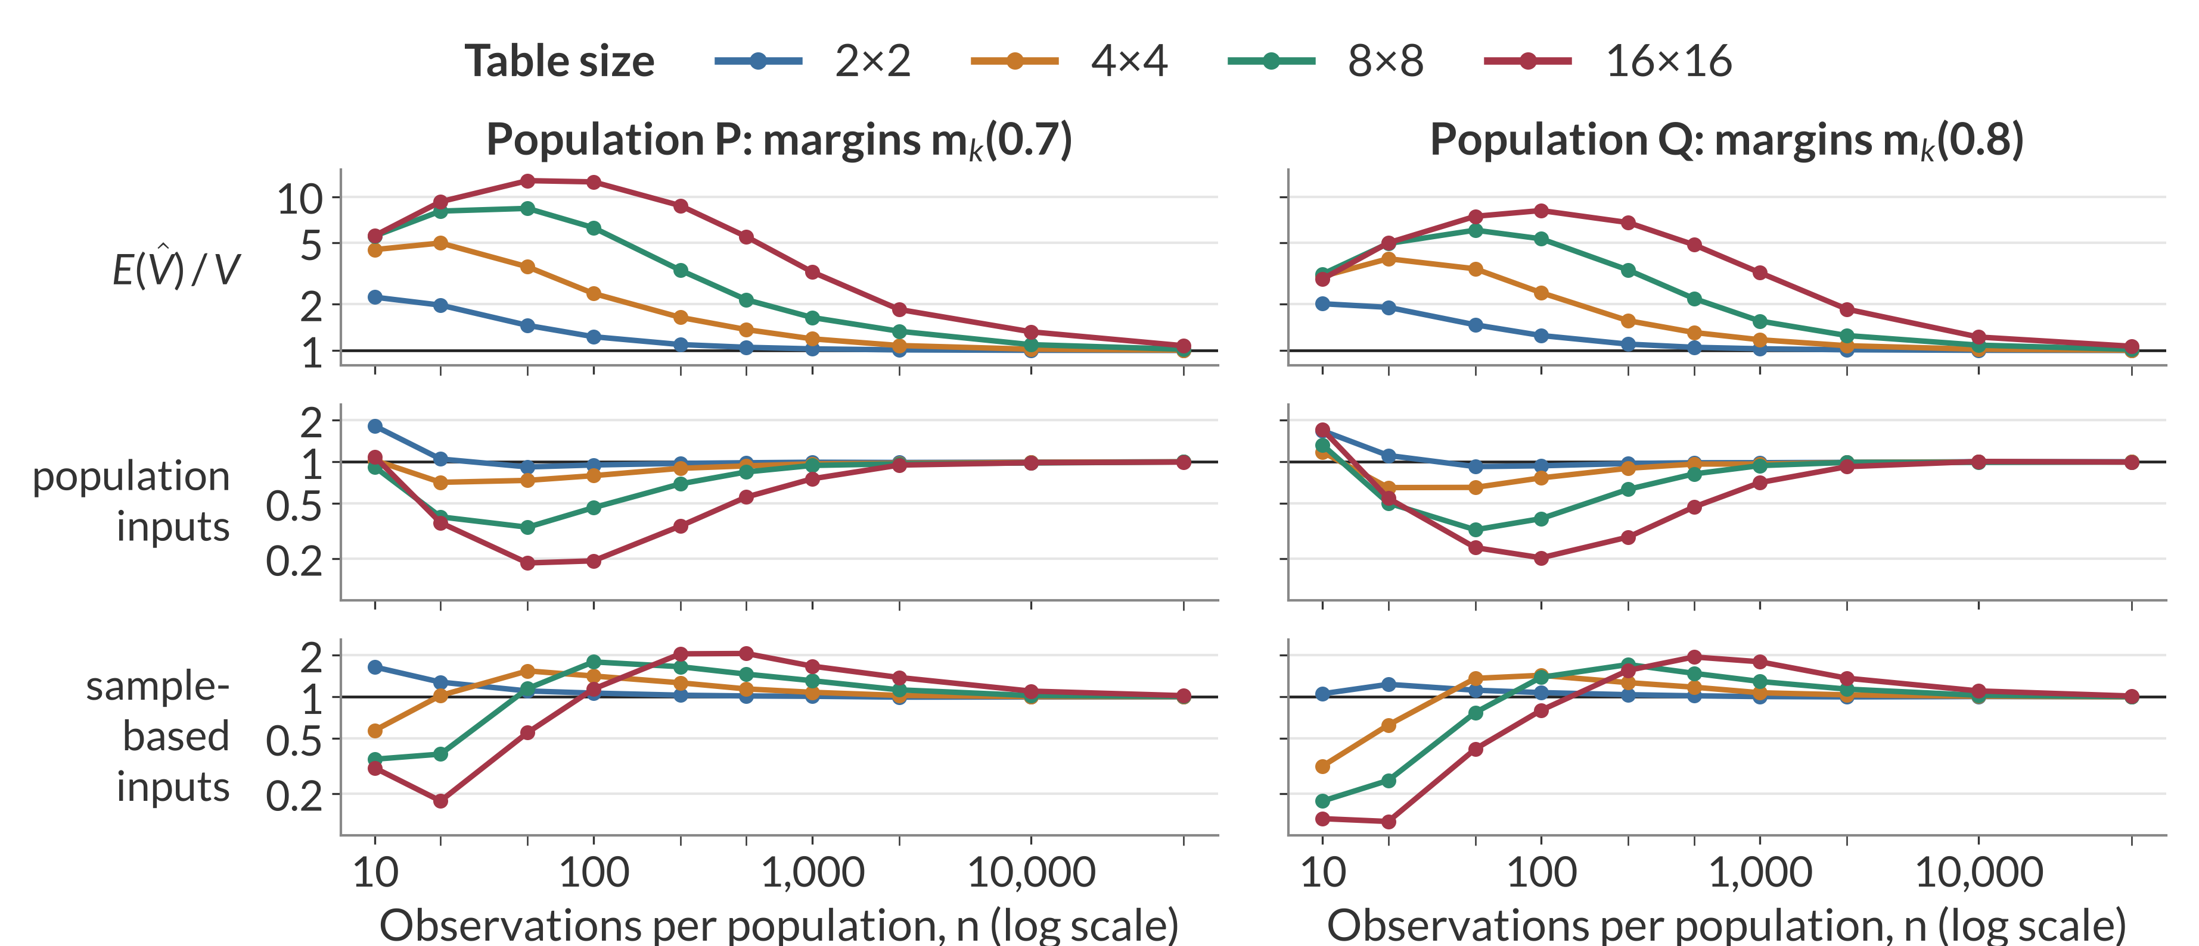
Approximation ratios across table sizes
Backup B4
Different-skew margins, common MI 0.02 nats; a ratio of one indicates agreement
Rows: mean of 𝑉̂ / 𝑉; population-input and sample-based variance predictions / observed variance. Thesis Figure 6.1
19
Notes:
Not part of the timed talk. Return to Slide 14 afterwards.
WHEN OPENING
Colour now identifies table size; the rows are three different ratios.
QUESTION ANSWERED
Is the 4×4 example representative of other sizes and both populations?
ANSWER TO GIVE
“The larger tables generally have higher mean peaks, deeper population-variance troughs and slower recovery in this family. Sample substitution can overpredict even while population inputs underpredict. The main slide isolates one slice so these quantities can first be understood separately.”
NOTES
Figure 6.2 separately checks how those moment errors affect df. In the worked 4×4/n=1,000 case, FO/target is about 0.73 and the exact values are 15.30/21.03; B2 explains why. Do not infer the mean of estimated df by inserting mean inputs into a nonlinear ratio. Full current Figure 6.2 remains in the thesis; it is not needed as another timed slide.
SOURCE
Sections 6.1.1–6.1.2, Figures 6.1–6.2 and current moments.csv; expected 80 rows: 4 sizes × 10 sample sizes × 2 populations.

Slide 20
Near-independence noise calculation
Backup B5
Setting: 4×4, n = 1,000, MI 0.0001; 𝑑 = 9 and 𝜅 = 2𝑛𝐼(𝑃) ≈ 0.2
$$G=2n\hat{I}\left(P\right) \dot{∼} χ_{d}^{2}\left(κ\right), {\hat{ν}}_{P}≈G/2$$
In 𝐺, 𝐼̂(𝑃) is the uncorrected plug-in MI, not a bias-corrected estimate.
Quantity | Local prediction | Observed (P)
Mean estimated component df | 4.60 | 4.86
Sampling-moment target | 9.00 | 9.12
Mean sample-based variance prediction / observed sampling variance | 1.96 | 1.97
Local approximations under fixed dimensions and positive limiting cell probabilities. Thesis Appendix A.2, Section 6.1.3
20
Notes:
Not part of the timed talk. Return to Slide 14 afterwards.
QUESTION ANSWERED
Why do the mean estimated df remain near five?
ANSWER TO GIVE
“Near independence, sampling noise creates apparent association. The quadratic likelihood-ratio approximation includes that noise. Substitution into the component formula gives roughly G divided by two, whose mean is about 4.6 in this setting. The population first-order formula instead approaches n times population MI. These are different approximations, which explains their separation.”
NOTES
Formulas: mean estimated component df (d + kappa)/2 = 4.60; sampling-moment target (d + kappa)^2/(d + 2 kappa) = 9.00; variance-prediction ratio 2(d + kappa)/(d + 2 kappa) = 1.96. The observed column is population P. The model predicts 9.00 for the target; it does not predict the observed 9.12 exactly.
SOURCE
Thesis Appendix A.2 and Section 6.1.3; Figure 6.3. These are local approximations under fixed dimensions and positive limiting cell probabilities, not exact finite-sample distribution identities.

Slide 21
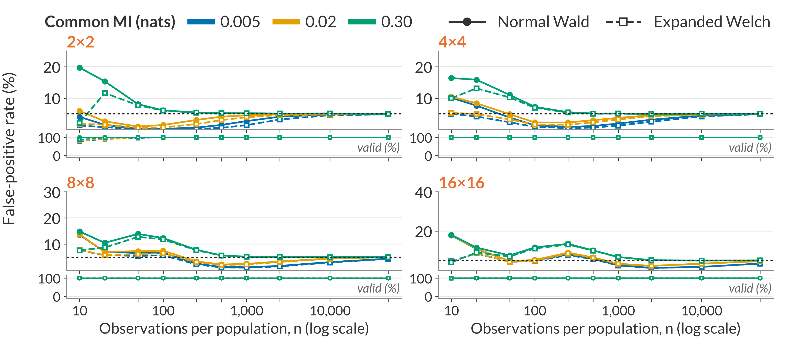
Full null results: uniform margins
Backup B6
Equal MI in P and Q; uniform margins in both populations
Rates divide valid rejections by all 100,000 repetitions; invalid outputs count as non-rejections. Rules in B3. Thesis Figure 6.4
21
Notes:
Not part of the timed talk. Return to Slide 14 afterwards.
WHEN OPENING
Colours here identify the common MI, not the method: solid lines with filled circles are Normal Wald, dashed lines with open squares are Expanded Welch. Lower strips show validity.
QUESTION ANSWERED
What happens outside the highlighted different-skew 16×16 example?
ANSWER TO GIVE
“Under the copying construction, equal MI and uniform margins give identical population tables. Their expected MI biases cancel in the difference, but errors in the uncertainty estimate and reference distribution can still cause excessive or conservative rejection. Increasing common MI changes those patterns.”
NOTES
All 120 settings for the uniform profile. Slide 9 used the 4×4, n = 20 slice of this page.
SOURCE
Final Figure 6.4 and balanced-null combined rates, uniform profile. This page contains all 120 settings for that profile.

Slide 22
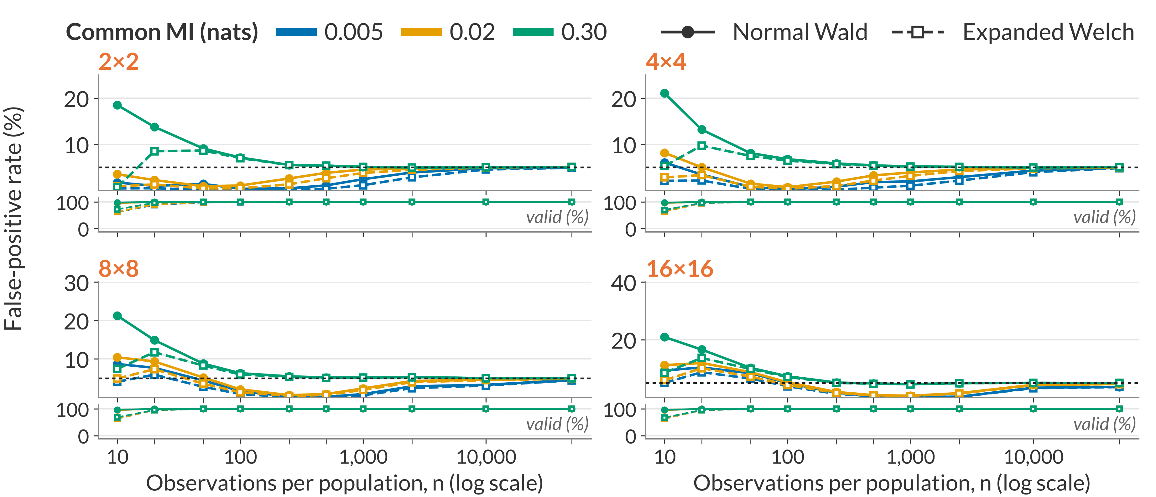
Full null results: same-skew margins
Backup B7
Equal MI; same-skew margins m_{k}(0.8) in P and Q
Rates divide valid rejections by all 100,000 repetitions; invalid outputs count as non-rejections. Rules in B3. Thesis Figure 6.5
22
Notes:
Not part of the timed talk. Return to Slide 14 afterwards.
WHEN OPENING
Colours here identify the common MI, not the method: solid lines with filled circles are Normal Wald, dashed lines with open squares are Expanded Welch. Lower strips show validity.
QUESTION ANSWERED
What changes when both populations have the same uneven category frequencies?
ANSWER TO GIVE
“The population tables are still identical under equal MI, so expected bias in the difference cancels. Uneven margins leave more rare category combinations. The conservative ranges persist beyond the smallest samples and are not explained solely by calculation failures. Expanded Welch lowers those already-low rates further.”
NOTES
All 120 settings for the same-skew profile.
SOURCE
Final Figure 6.5 and balanced-null combined rates, same-skew profile. This page contains all 120 settings for that profile.

Slide 23
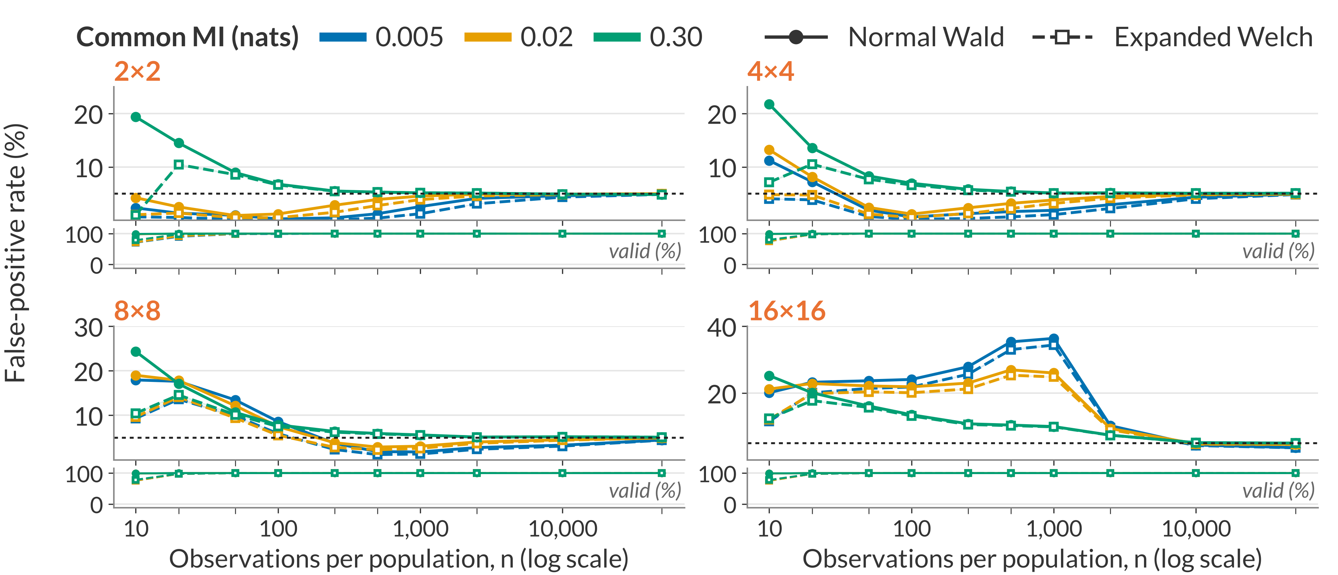
Full null results: different-skew margins
Backup B8
Equal MI; m_{k}(0.7) in P and m_{k}(0.8) in Q
Rates divide valid rejections by all 100,000 repetitions; invalid outputs count as non-rejections. Rules in B3. Thesis Figure 6.6
23
Notes:
Not part of the timed talk. Return to Slide 14 afterwards.
WHEN OPENING
Colours here identify the common MI, not the method: solid lines with filled circles are Normal Wald, dashed lines with open squares are Expanded Welch. Lower strips show validity.
QUESTION ANSWERED
Are the severe failures restricted to the largest table, and what is visible over the complete margin-specific grid?
ANSWER TO GIVE
“Here equal MI permits different population tables. The remaining MI biases need not cancel, and in the sparse largest table they can shift the estimated difference substantially away from zero. The smaller-table patterns and the dependence on common MI remain visible in this complete slice of the null grid.”
NOTES
All 120 settings for the different-skew profile. The Slide 10 diagnostic table uses the MI 0.02, n = 1,000 slice of these populations.
Additional anchor: At MI .005, n=1,000 and 16×16, Wald is 36.38% and Expanded Welch 34.38%, both 100% valid. This is a different common-MI level from the diagnostic table's .02; do not interchange the numbers.
SOURCE
Final Figure 6.6 and balanced-null combined rates, different-skew profile. This page contains all 120 settings for that profile.

Slide 24
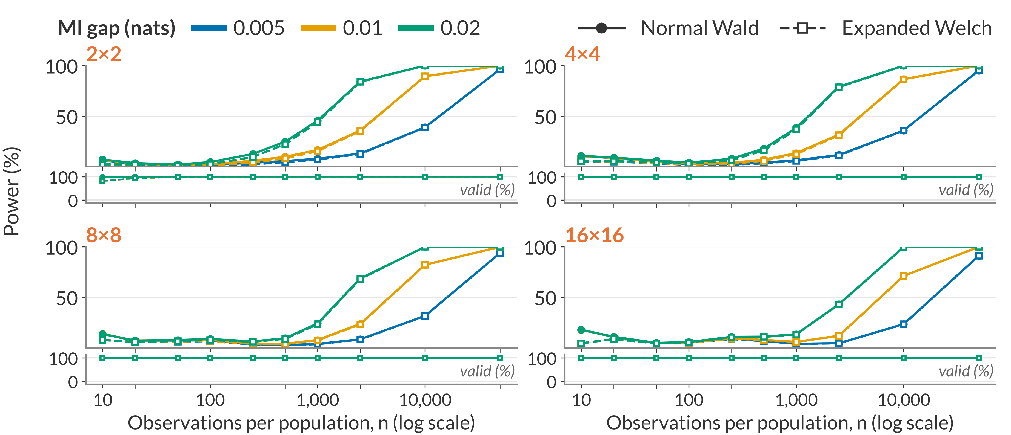
Full power results: uniform margins
Backup B9
Uniform margins; MI in P = 0.02 nats
Rates divide valid rejections by all 100,000 repetitions; invalid outputs count as non-rejections. Rules in B3. Thesis Figure 6.7
24
Notes:
Not part of the timed talk. Return to Slide 14 afterwards.
WHEN OPENING
Colours here identify the MI gap, not the method: solid lines with filled circles are Normal Wald, dashed lines with open squares are Expanded Welch. Lower strips show validity.
QUESTION ANSWERED
Do the gap and sample-size patterns hold outside the single curve and snapshot?
ANSWER TO GIVE
“The complete uniform-margin grid shows the increase in detection with sufficient observations and the stronger-gap advantage. Larger tables need more data. Expanded Welch never exceeds Wald under the usual thresholds, with method differences becoming small at larger sample sizes.”
NOTES
120 settings, 240 method rows for this margin profile.
SOURCE
Section 6.3.1, Figure 6.7; power rates, profile=uniform, denominator=all. At n=10,000 and gap=.01, EW is 89.44% for 2×2 and 71.12% for 16×16. These values describe the stated population family.

Slide 25
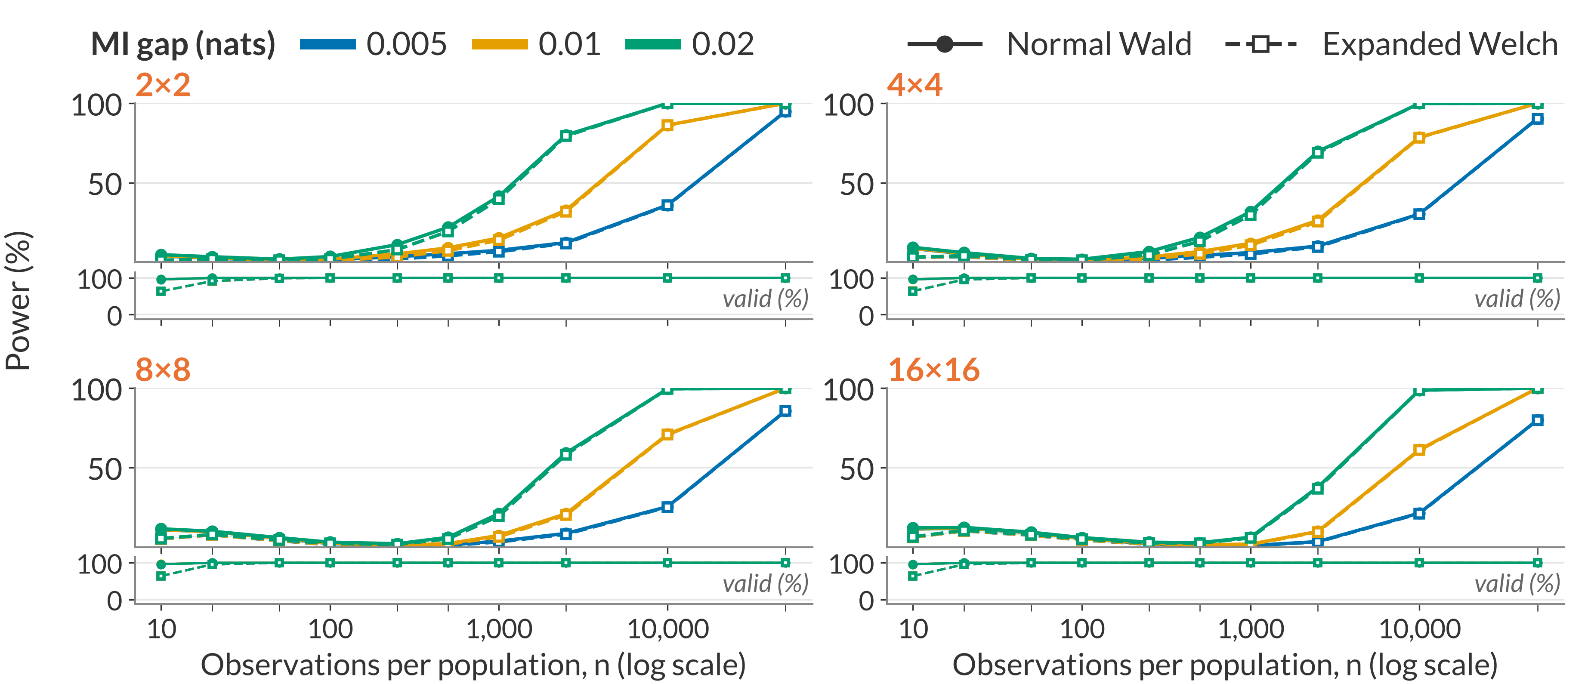
Full power results: same-skew margins
Backup B10
Same-skew margins m_{k}(0.8) in P and Q; MI in P = 0.02 nats
Rates divide valid rejections by all 100,000 repetitions; invalid outputs count as non-rejections. Rules in B3. Thesis Figure 6.8
25
Notes:
Not part of the timed talk. Return to Slide 14 afterwards.
WHEN OPENING
Colours here identify the MI gap, not the method: solid lines with filled circles are Normal Wald, dashed lines with open squares are Expanded Welch. Lower strips show validity.
QUESTION ANSWERED
Do the power patterns also occur when both groups have the same uneven margins?
ANSWER TO GIVE
“These power curves use the same uneven margins in both populations. Larger tables need more observations, and the smaller MI gap remains harder to detect. For example, at n=50,000, the 16×16 Expanded Welch power is 79.87% for the smallest gap, compared with more than 99.9% for each of the two larger gaps. The method difference is smaller than these gap and setting effects at larger sample sizes.”
NOTES
All 120 settings for the same-skew power profile.
SOURCE
Final Figure 6.8; Section 6.3.2; MI-gap combined rates, same-skew profile. This page contains all 120 settings for that profile.

Slide 26
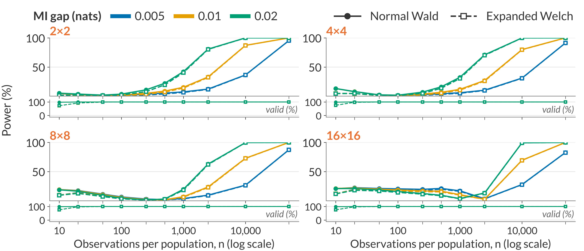
Full power results: different-skew margins
Backup B11
m_{k}(0.7) in P, m_{k}(0.8) in Q; MI in P = 0.02 nats
Rates divide valid rejections by all 100,000 repetitions; invalid outputs count as non-rejections. Rules in B3. Thesis Figure 6.9
26
Notes:
Not part of the timed talk. Return to Slide 14 afterwards.
WHEN OPENING
Colours here identify the MI gap, not the method: solid lines with filled circles are Normal Wald, dashed lines with open squares are Expanded Welch. Lower strips show validity.
QUESTION ANSWERED
How does the bias-related failure vary with gap and table size?
ANSWER TO GIVE
“Unequal residual biases can shift the estimated difference opposite to its true sign. The two-sided rate includes those rejections. As the bias shrinks, rejection can first fall and later recover. Gap size and margins therefore affect power through the estimator's behaviour as well as the true separation.”
NOTES
120 settings, 240 method rows. The main point is 16×16, gap 0.01, n = 1,000.
At the main point the mean estimate is +.0206714 for true −.01. Of 9,662 EW rejections, 9,659 are positive and 3 negative. Do not apply that conditional percentage to the entire grid or all 100,000 estimates.
SOURCE
Section 6.3.3, Figure 6.9 and current power CSVs, profile=different_skew, denominator=all.

Slide 27
Application details and comparison family
Backup B12
Unadjusted p-values for six exploratory comparisons; Holm adjusts each method separately
Dataset | Predictor | Normal Wald | Expanded Welch
Adult | Occupation | 1.184×10⁻⁴⁴ | 1.635×10⁻⁴²
Adult | Education | 1.890×10⁻³⁴ | 4.930×10⁻³³
Online Shoppers | Month | 4.714×10⁻⁵ | 3.726×10⁻⁴
Student Performance | Study time | 0.1982 | 0.2339
Student Performance | Maternal education | 0.8361 | 0.8468
Online Shoppers | Weekend | 0.9554 | 0.9601
Holm-adjusted month p-values: Normal Wald 0.000189; Expanded Welch 0.00149
Becker and Kohavi (1996); Sakar and Kastro (2018); Cortez (2008); Holm (1979). Thesis Appendix B.7, Table B.1
27
Notes:
Not part of the timed talk. Return to Slide 14 afterwards.
QUESTION ANSWERED
Why were six comparisons adjusted, and what else was tested?
ANSWER TO GIVE
“The two shopping examples were selected from a fixed six-comparison exploratory family across three public datasets. I apply Holm's adjustment separately to each method's six p-values. Both adjusted month results remain below 0.05. This adjustment addresses multiplicity; it does not establish that the approximate underlying p-values are calibrated.”
NOTES
Groups: 1,694 sessions labelled New_Visitor (P) and 10,551 labelled Returning_Visitor (Q); the 85 Other sessions are excluded. The dataset has 12,330 sessions, each from a different user according to its documentation. Outcome: the Boolean Revenue variable.
Month: January and April have no recorded sessions, so each month table is 10×2. All ten months occur in both groups, although the new-visitor February row contains one session and no purchase. Zero cells are retained without smoothing.
Month degrees of freedom: component 12.93 (new) and 187.93 (returning); combined 26.79.
Weekend: corrected MI 0.000664 (new) and 0.000727 (returning); T = −0.056; Expanded Welch df 2.18; p-values 0.9554 (Wald) and 0.9601 (Expanded Welch). Neither test rejects, and this non-rejection does not establish equality.
Holm: order each method's six p-values from smallest to largest, multiply by 6, 5, 4, 3, 2 and 1, take the cumulative maximum and cap at one. Month is the third smallest, so its multiplier is 4.
SOURCE
Thesis Section 6.4 and Appendix B.7, Table B.1; the application protocol. Becker and Kohavi (1996); Sakar and Kastro (2018); Cortez (2008); Holm (1979).

Slide 28
References: MI and testing foundations
Backup B13
Bossomaier, T., Barnett, L., Harré, M. and Lizier, J. T. (2016). An Introduction to Transfer Entropy: Information Flow in Complex Systems. Springer, Cham. doi:10.1007/978-3-319-43222-9
Moddemeijer, R. (1989). On estimation of entropy and mutual information of continuous distributions. Signal Processing, 16(3), 233–248. doi:10.1016/0165-1684(89)90132-1
Paninski, L. (2003). Estimation of entropy and mutual information. Neural Computation, 15(6), 1191–1253. doi:10.1162/089976603321780272
Mora, R. and Ruiz-Castillo, J. (2009). The statistical properties of the mutual information index of multigroup segregation. Working Paper, Economic Series (48), 09-84, Universidad Carlos III de Madrid, Departamento de Economía.
Satterthwaite, F. E. (1946). An approximate distribution of estimates of variance components. Biometrics Bulletin, 2(6), 110–114. doi:10.2307/3002019
Welch, B. L. (1947). The generalization of “Student's” problem when several different population variances are involved. Biometrika, 34(1–2), 28–35. doi:10.1093/biomet/34.1-2.28
28
Notes:
Not part of the timed talk. Use this page if a source is requested. Entries follow the thesis bibliography.

Slide 29
References: related methods and evaluation
Backup B14
Hutcheson, K. (1970). A test for comparing diversities based on the Shannon formula. Journal of Theoretical Biology, 29(1), 151–154. doi:10.1016/0022-5193(70)90124-4
Pan, W. and Wall, M. M. (2002). Small-sample adjustments in using the sandwich variance estimator in generalized estimating equations. Statistics in Medicine, 21(10), 1429–1441. doi:10.1002/sim.1142
Morris, T. P., White, I. R. and Crowther, M. J. (2019). Using simulation studies to evaluate statistical methods. Statistics in Medicine, 38(11), 2074–2102. doi:10.1002/sim.8086
Sakar, C. and Kastro, Y. (2018). Online Shoppers Purchasing Intention Dataset. UCI Machine Learning Repository. doi:10.24432/C5F88Q
Holm, S. (1979). A simple sequentially rejective multiple test procedure. Scandinavian Journal of Statistics, 6(2), 65–70. https://www.jstor.org/stable/4615733
29
Notes:
Not part of the timed talk. Use this page if a source is requested. Entries follow the thesis bibliography.

